Slide 1
Alternative Credit Scoring
Monirul Islam Mahmud
Md. Shihab Reza
Farhana Elias Richie
Kazi Aniya Ahmed
Marjana Ahammad
Your Name • 09.04.20XX

Slide 2
Overview
Update - 4th October
Recent Progress:
All Dataset Download.
Handling the Null values.
Unnecessary features drop.
Show Correlation Matrix.
Show Histogram, Barchart and Boxplot.
Normalization & Label Encoding.

Slide 3
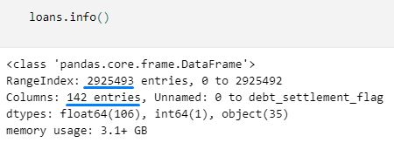
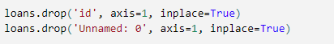
Progress - Lending Club Dataset

Slide 4
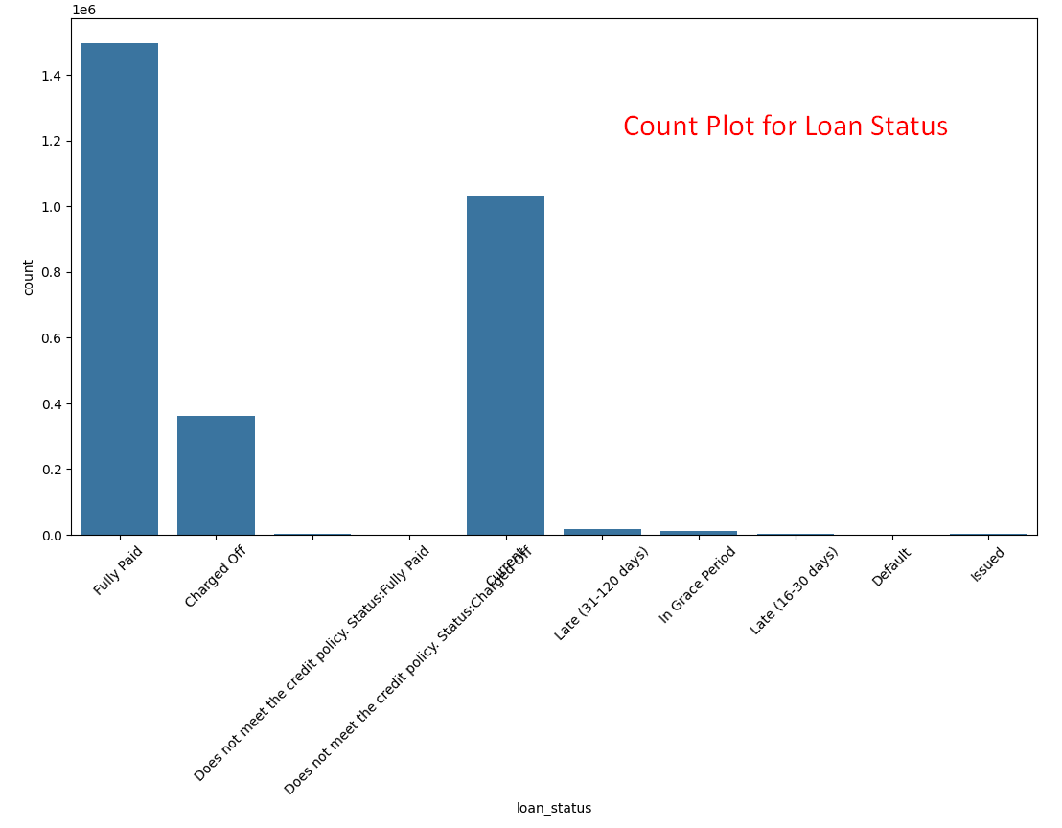
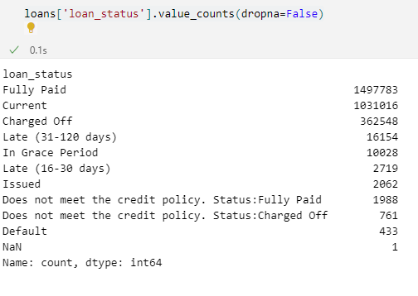
Count Plot of Loan Status

Slide 5
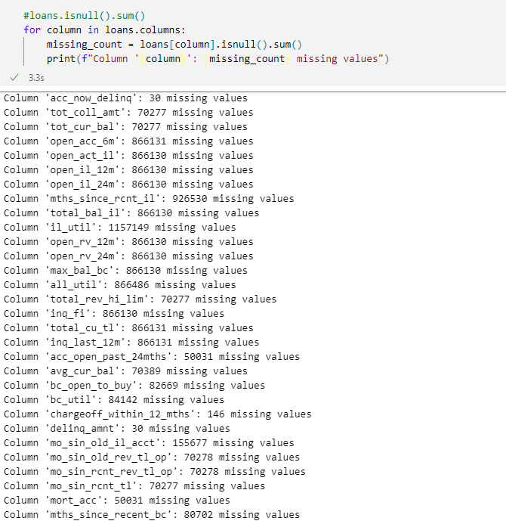
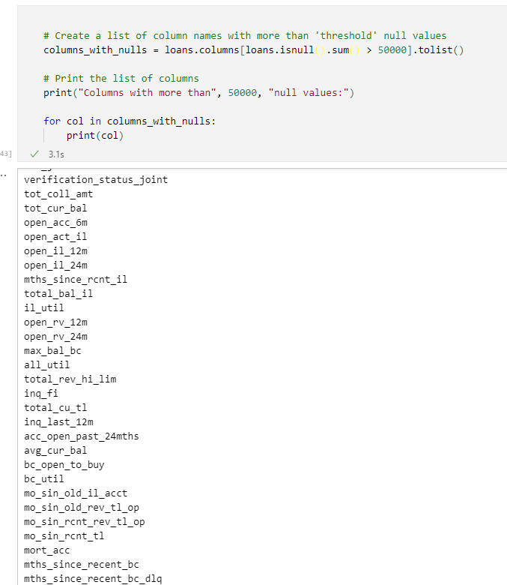
Null value handling

Slide 6
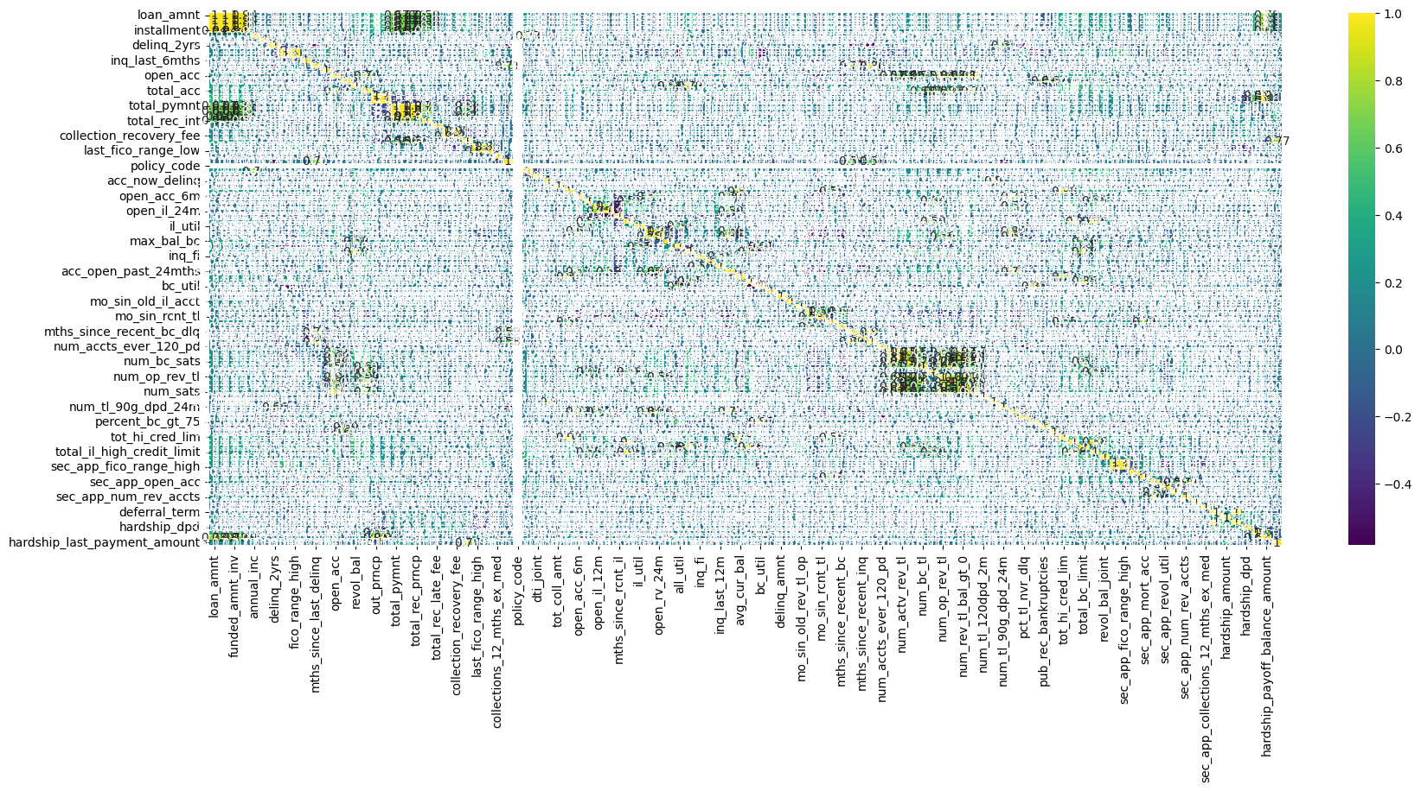
Correlation matrix

Slide 7
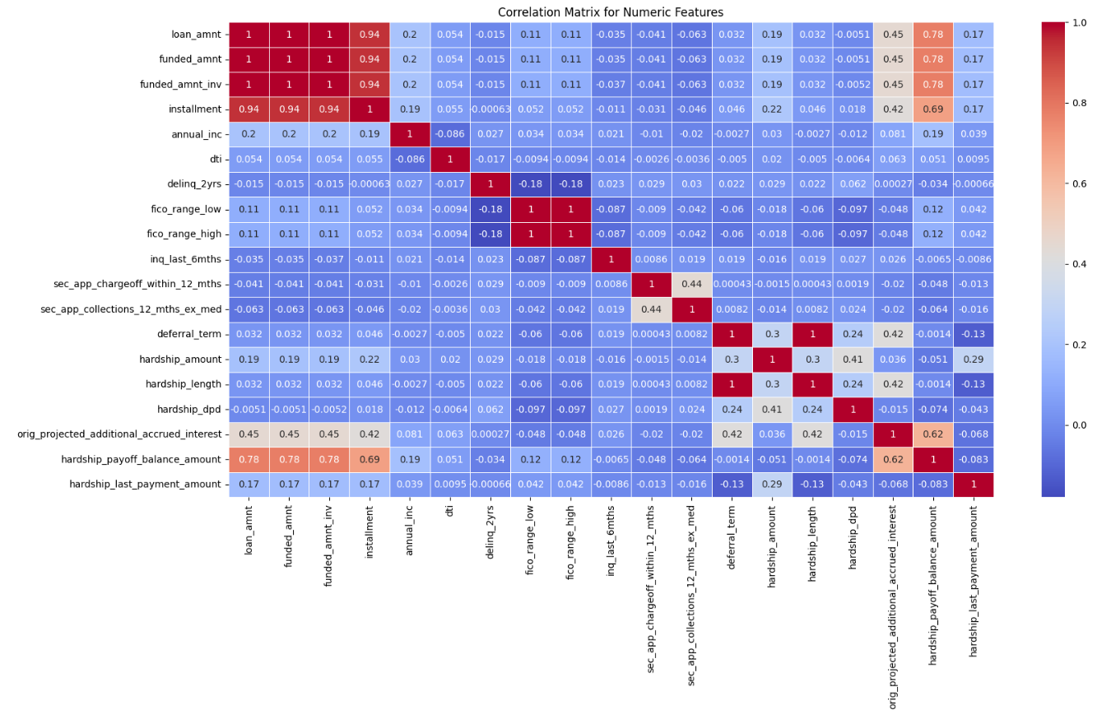
Correlation matrix

Slide 8
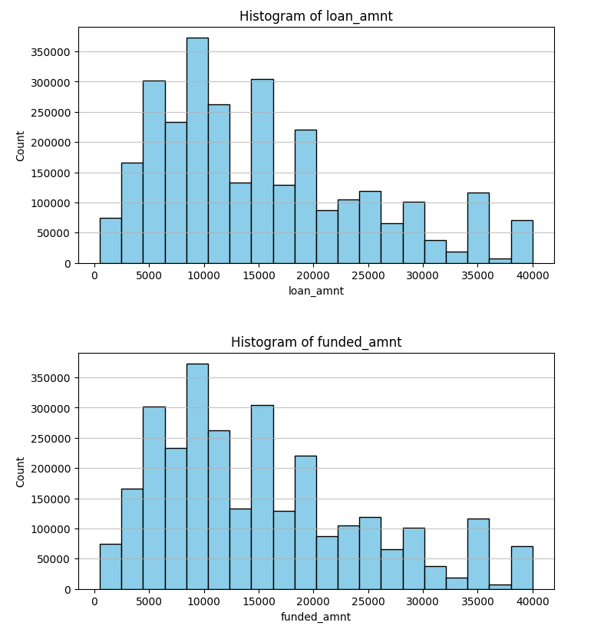
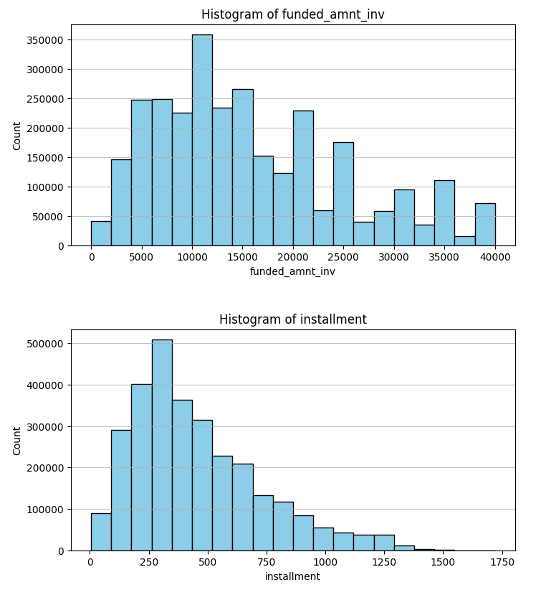
Histogram for Numerical Features

Slide 9
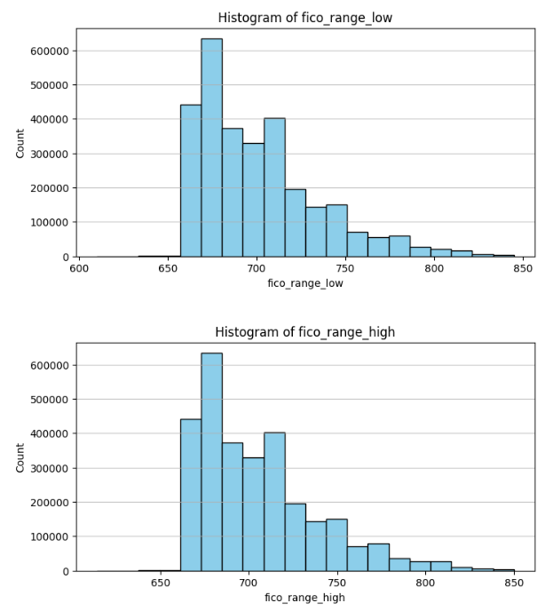
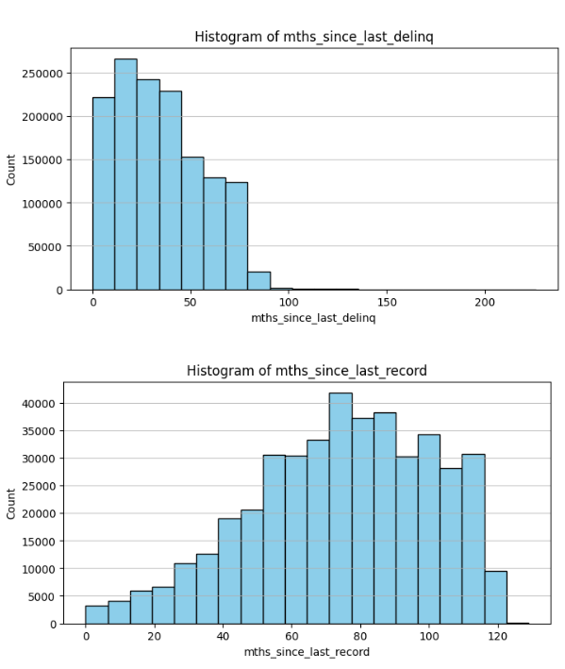

Slide 10
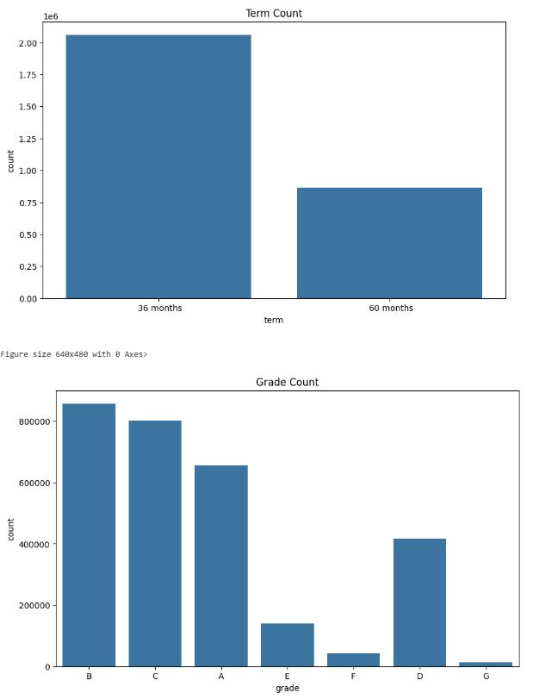
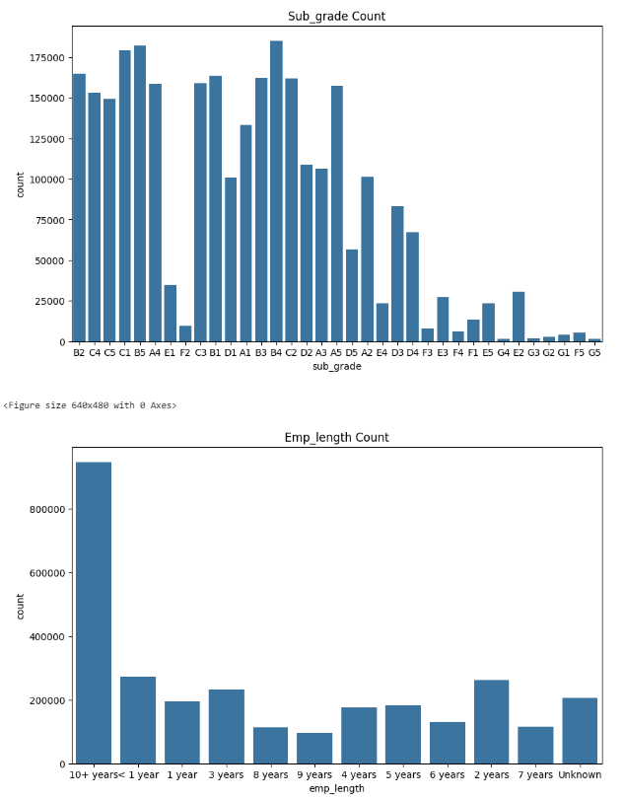
Bar Chart for Categorical Features

Slide 11
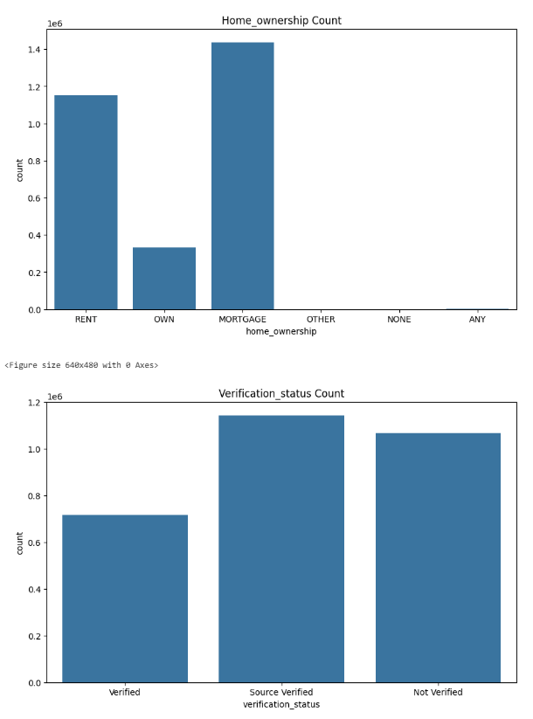
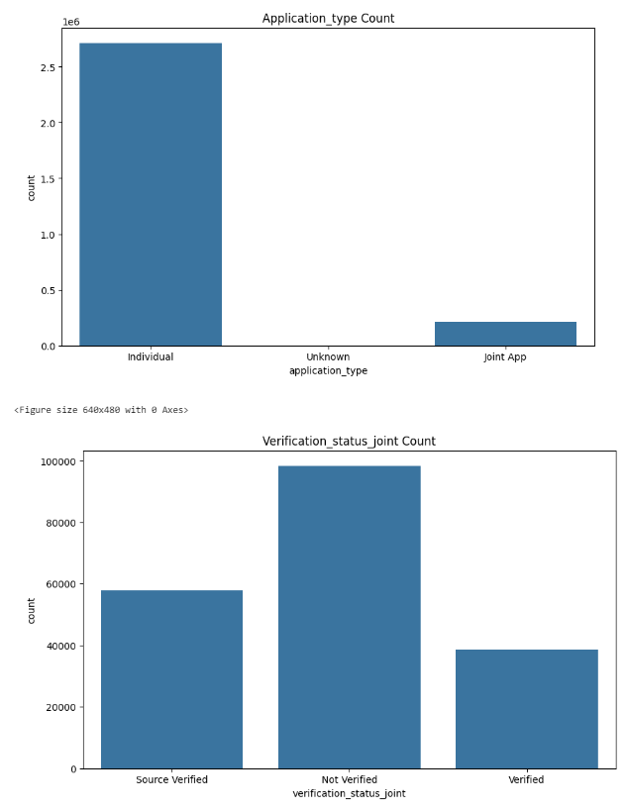

Slide 12
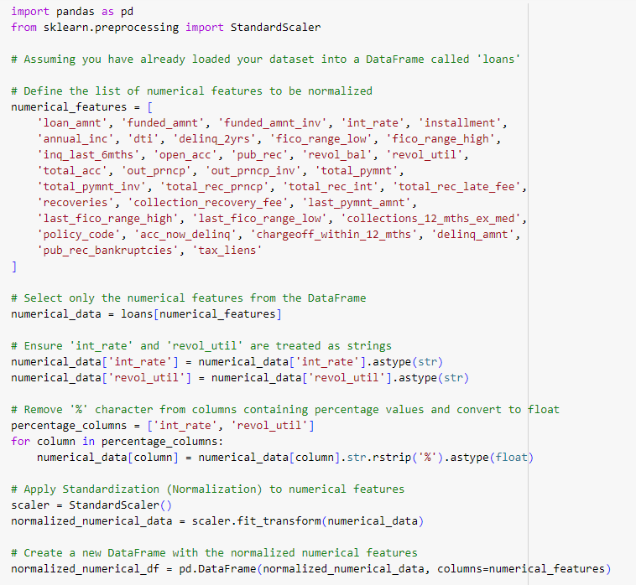
Normalization - Standard Scaler

Slide 13
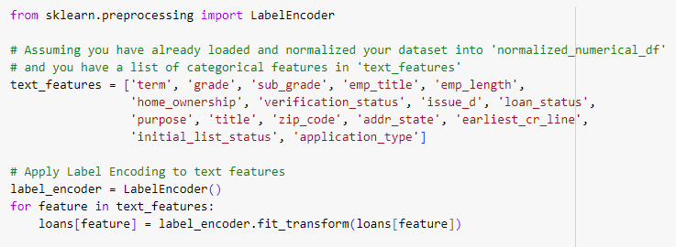
Label Encoder

Slide 14

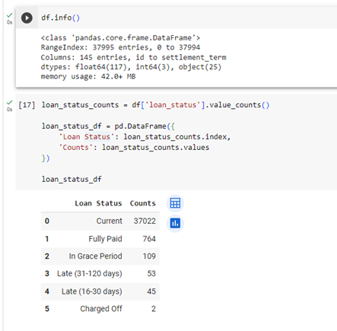
Progress - Lending Club Loan Dataset

Slide 15
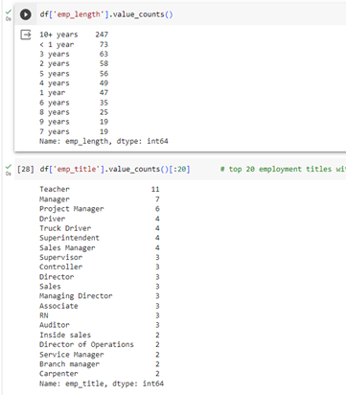
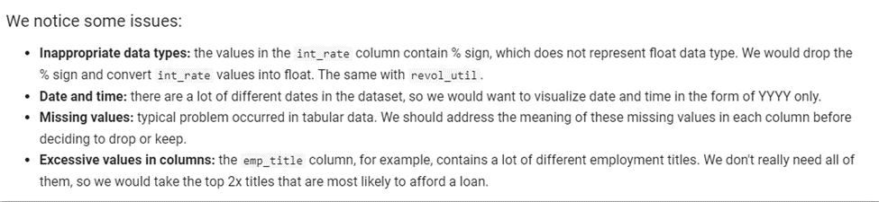
Issue about this dataset

Slide 16
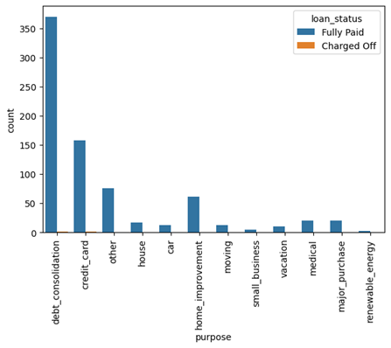
Loan Reason

Slide 17
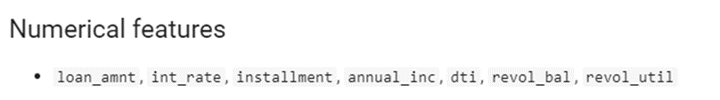
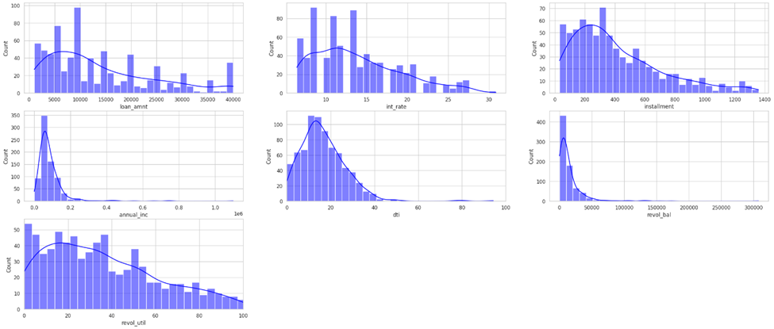

Slide 18
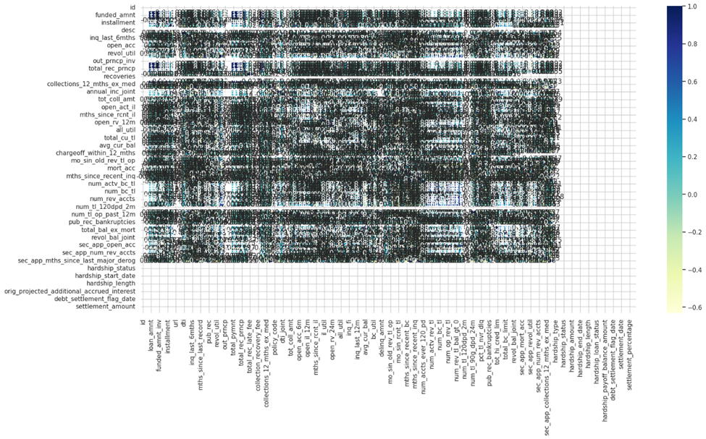
Correlation Matrix

Slide 19
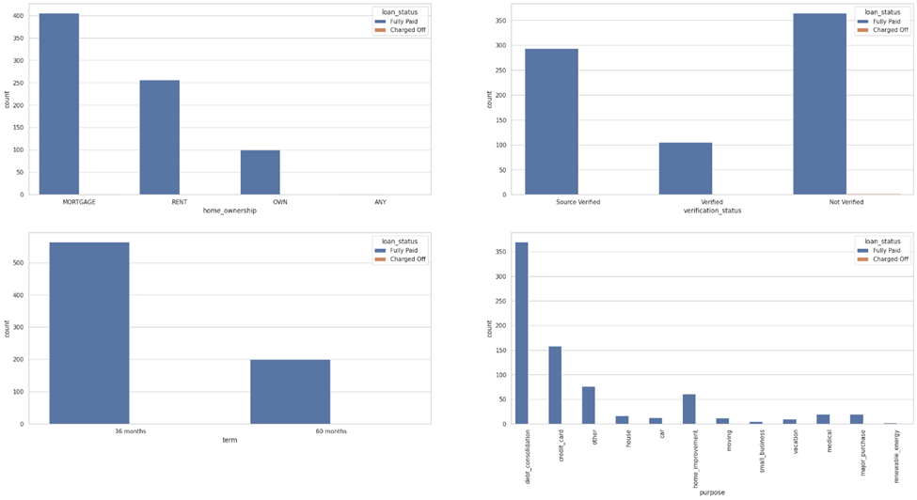

Slide 20
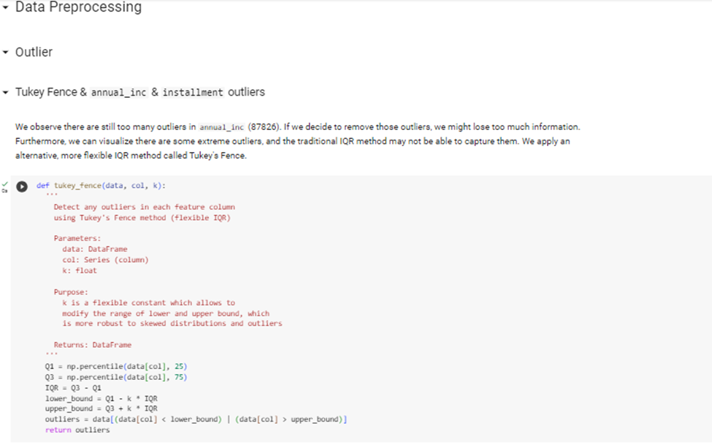
Data Preprocessing

Slide 21
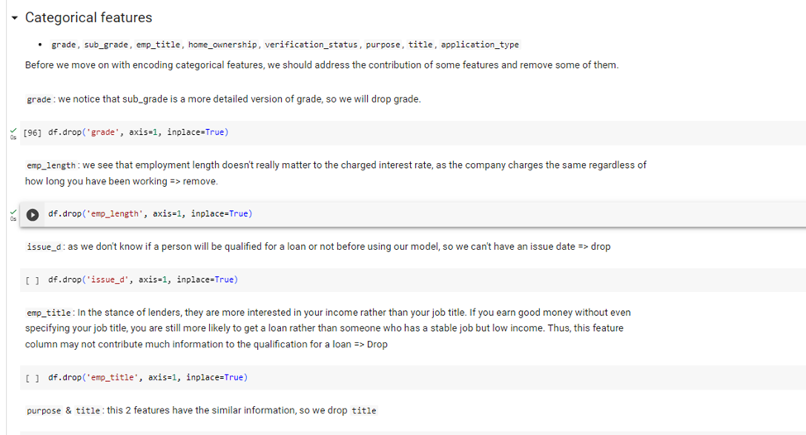

Slide 22
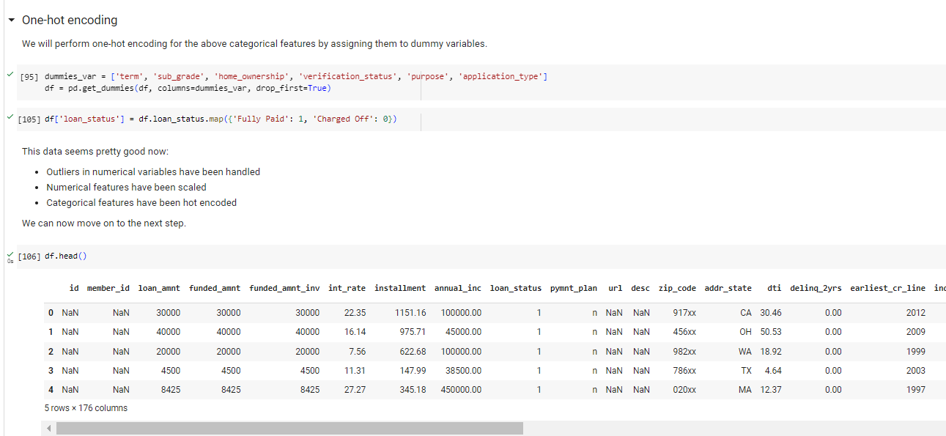

Slide 23
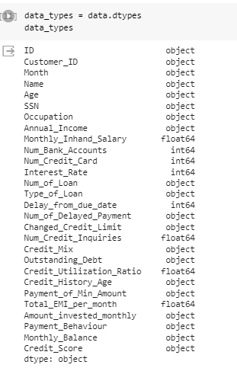

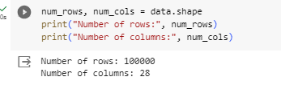
Progress - Credit score classification

Slide 24
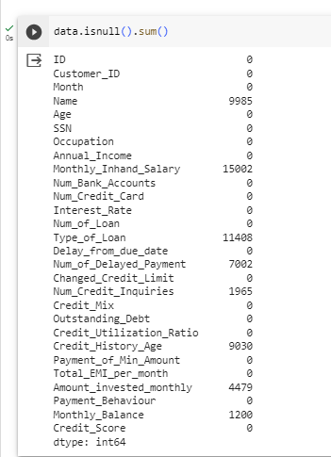
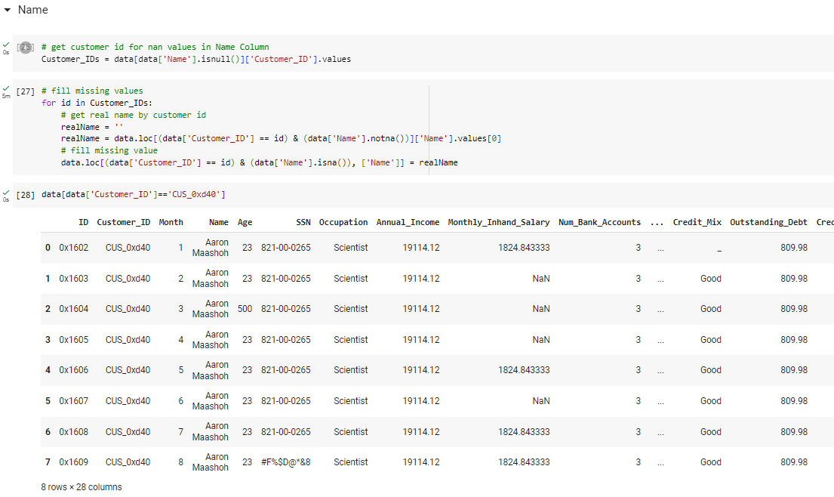
Null Value Check

Slide 25
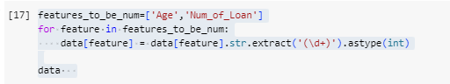
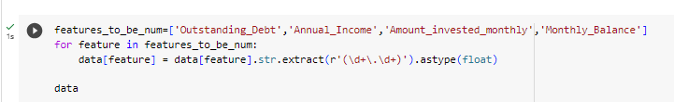
Converting to Numeric representation

Slide 26
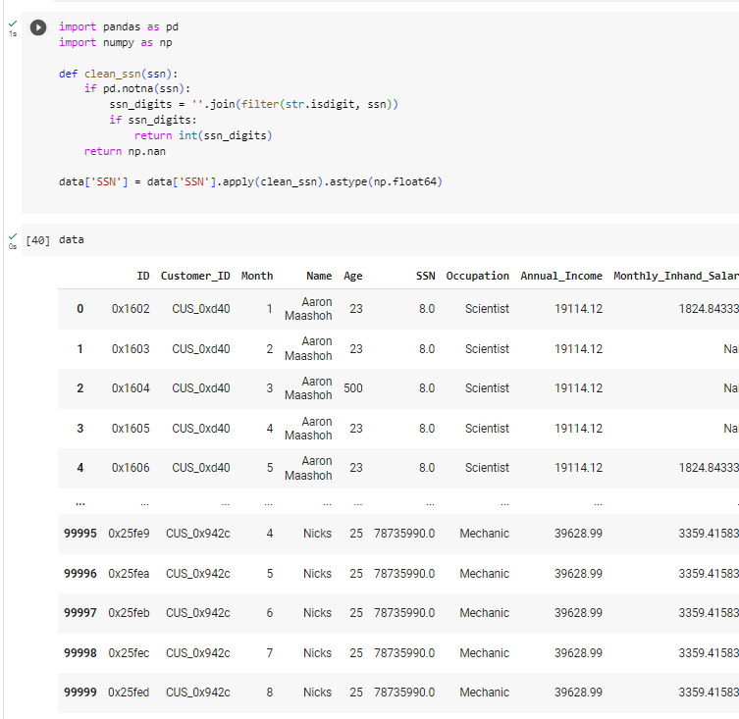
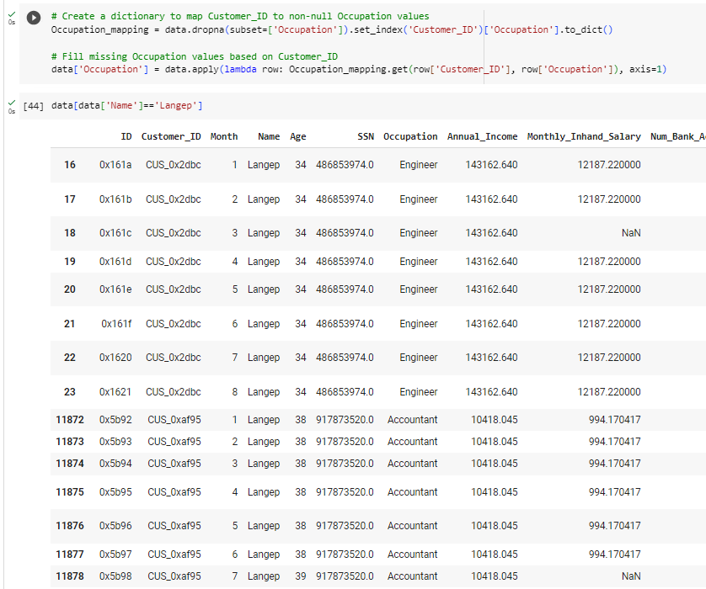
SSN
Occupation

Slide 27
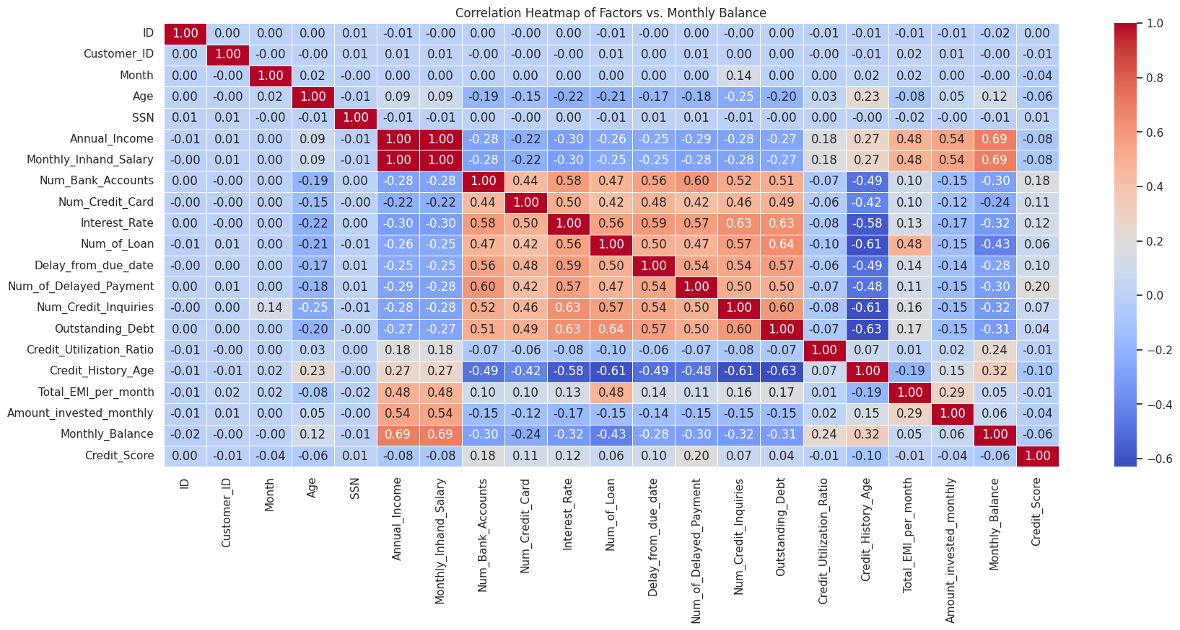
Correlation Heatmap

Slide 28
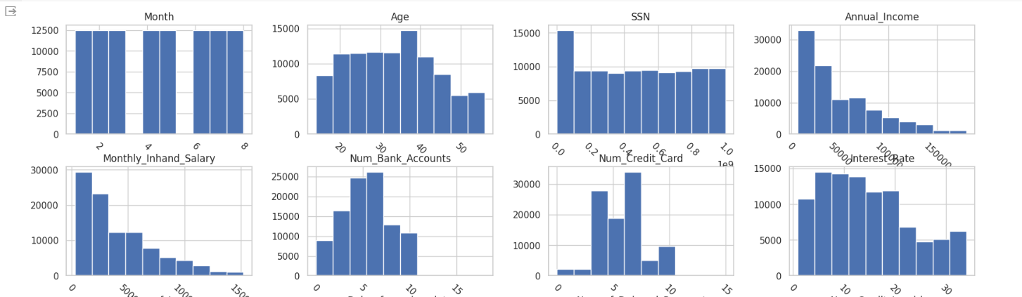
Histograms

Slide 29
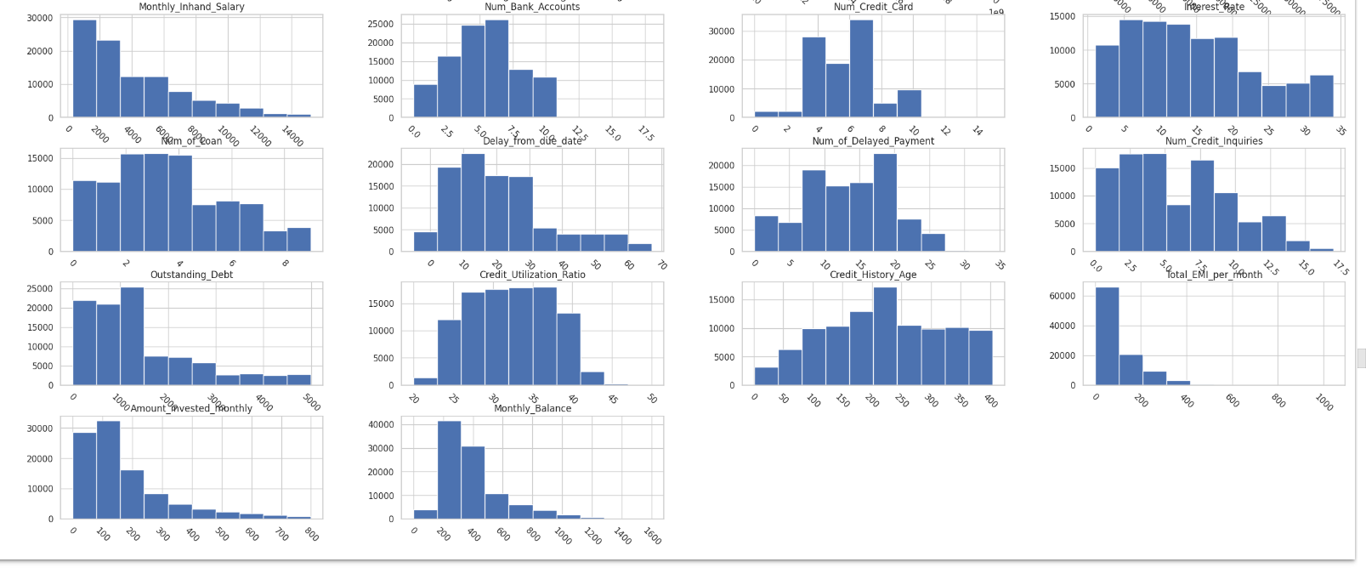

Slide 30
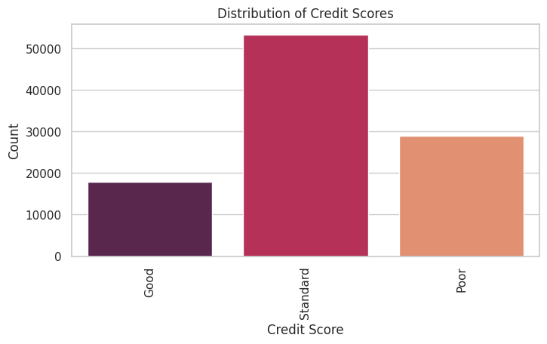
Distribution of Credit score

Slide 31
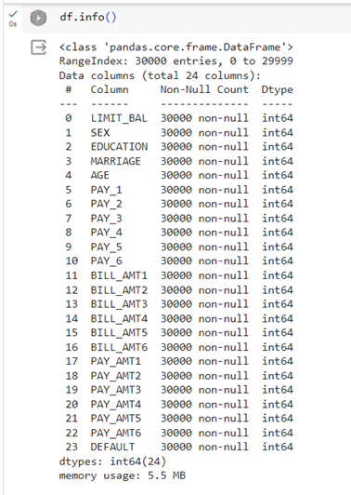
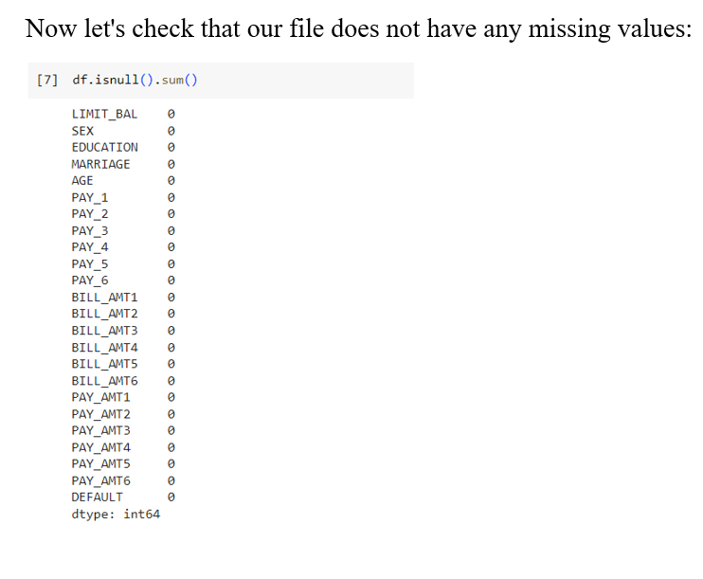
Progress - Default of credit card clients

Slide 32
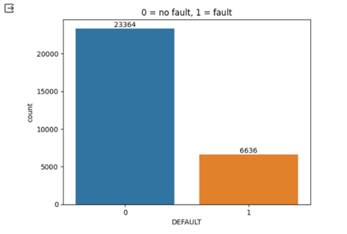

Slide 33
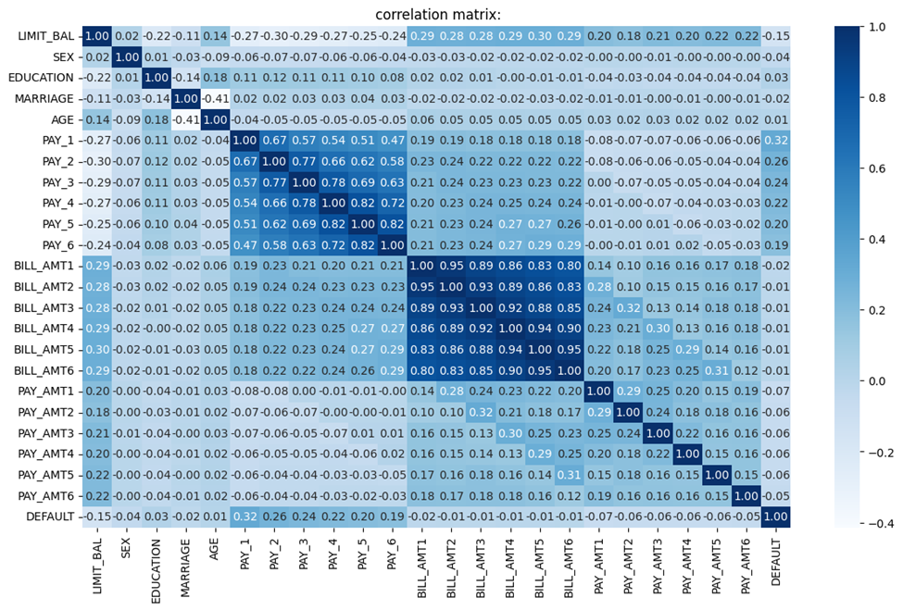
Correlation Matrix

Slide 34
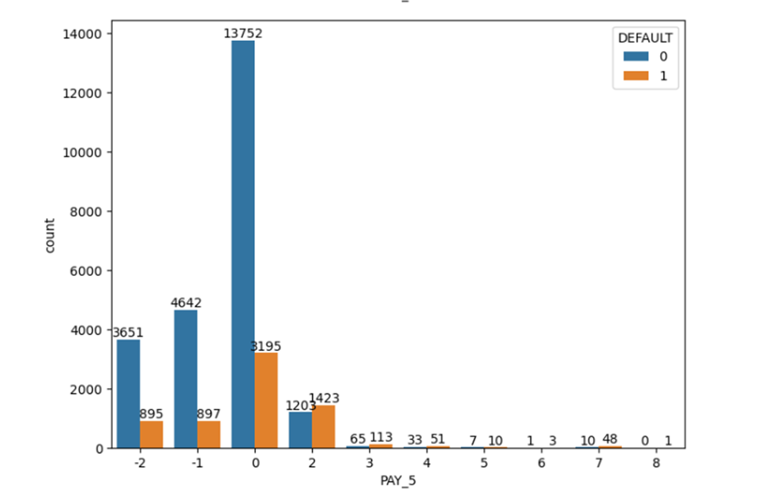
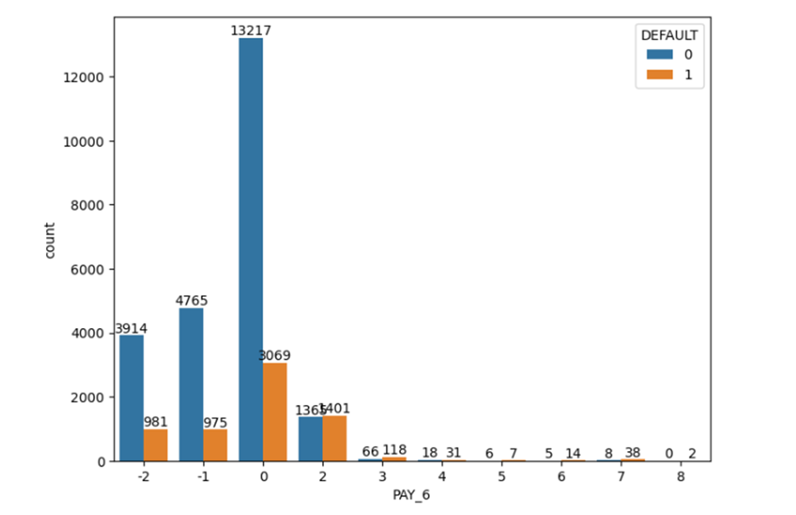
Observation from PAY_1 to pay_6

Slide 35
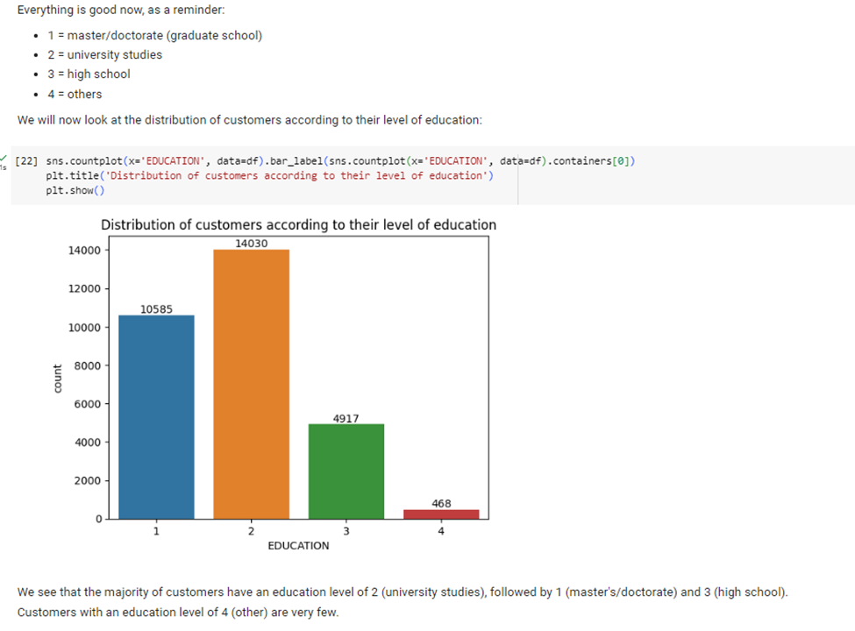
Education

Slide 36
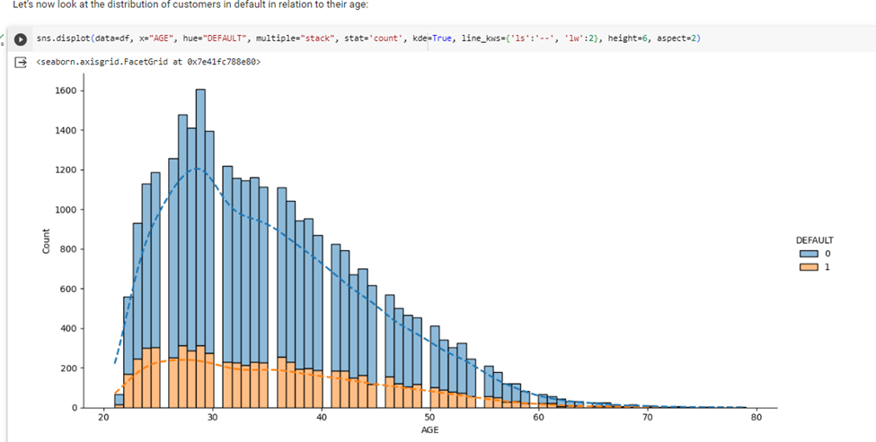
Default relation to their age

Slide 37
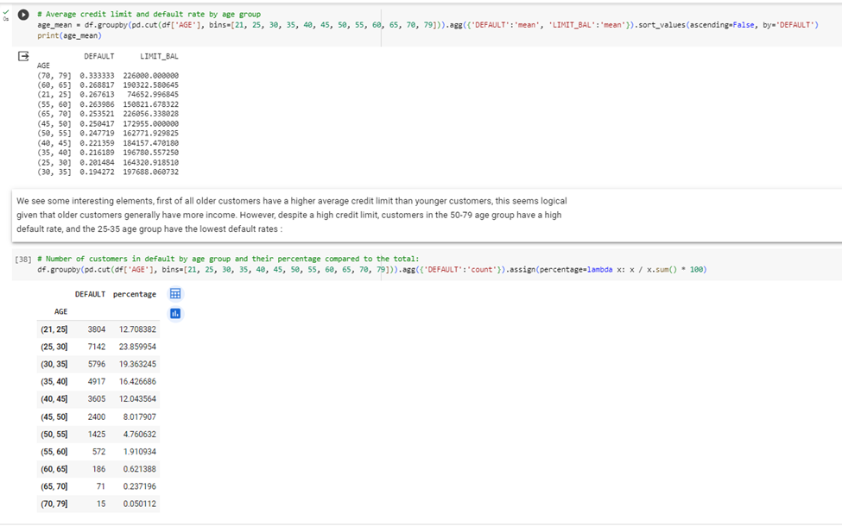


Slide 38


Slide 39

Overall Observation

Slide 40



Progress - Credit Risk Dataset

Slide 41


Count Plot of Loan Status

Slide 42



Null value handling

Slide 43

Correlation matrix

Slide 44

Box Plot

Slide 45





Histogram for all Numerical Features

Slide 46



Slide 47

Normalization - Standard Scaler

Slide 48


Label Encoder

Slide 49


Credit Card Data from book "Econometric Analysis”

Slide 50


Count Plot of Majorcards

Slide 51



Distribution plot

Slide 52


Handle Null Values

Slide 53

Correlation matrix

Slide 54


Histogram for all Numerical Features

Slide 55



Slide 56

Label Encoder

Slide 57

Harvard Dataset

Slide 58


Count Plot of Loans

Slide 59



Handle Null Values

Slide 60

Correlation matrix

Slide 61


Histogram for all Numerical Features

Slide 62

Normalization

Slide 63

Label Encoder

Slide 64
Goals
More Data Cleaning (using strip, remove %, #, @, $
Run Machine Learning and Deep Learning model.
Apply XAI techniques SHAP & LIME.

Slide 65

Thank You!

